Slide 1
Big Mountain Resort
What is the optimal ticket price? What changes can be made to the resort to support these changes.

Slide 2
Recomendation
Increase the ticket price from $81 to $96.55
Depending on costs add a 1 more run, 1 more chairlift, and increase change in elevation.
Considering closing a 1-5 runs.

Slide 3
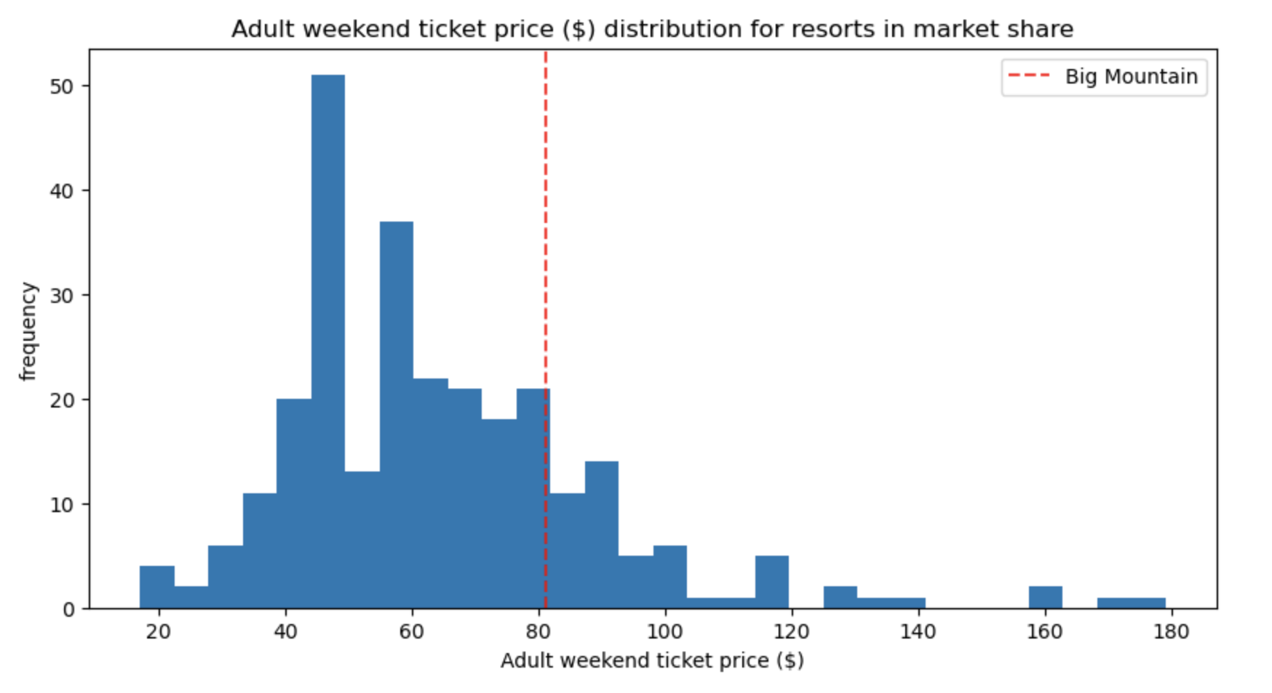
We are already charging a premium

Slide 4
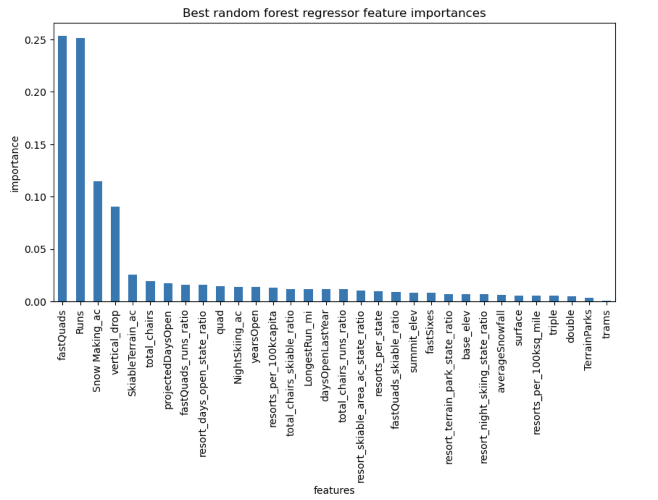
What features matter?

Slide 5
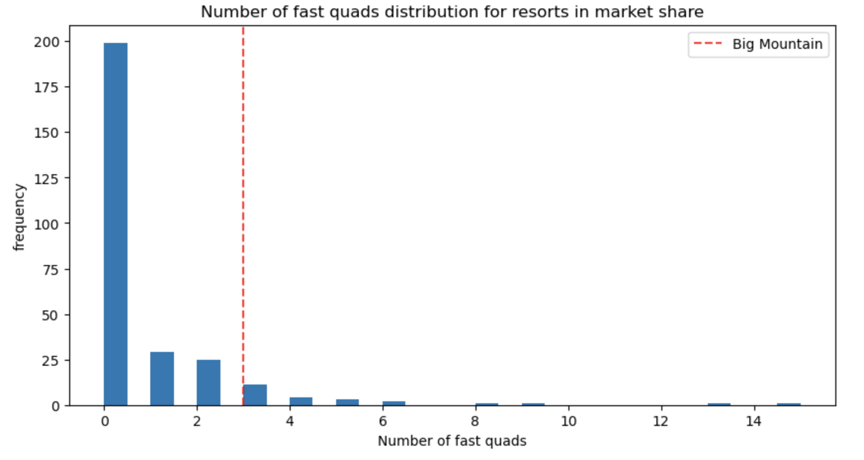
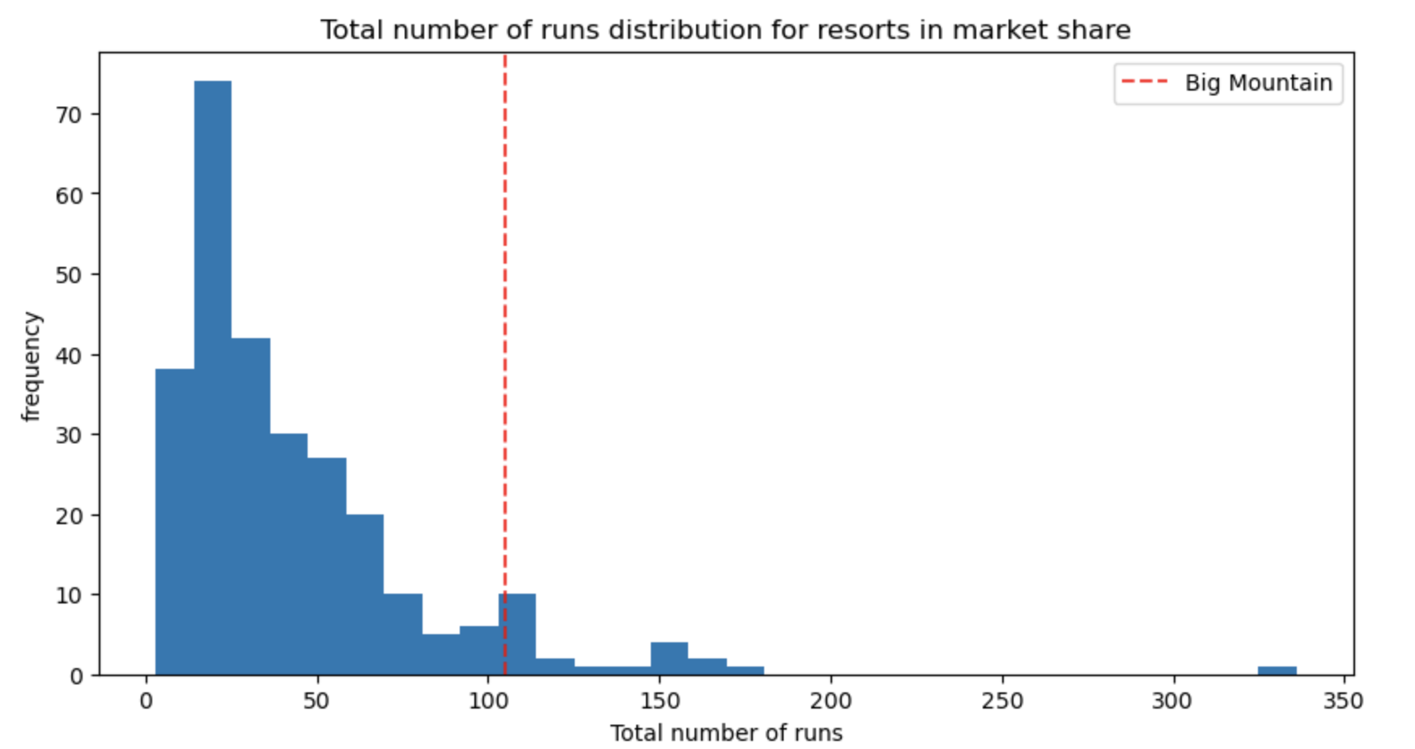
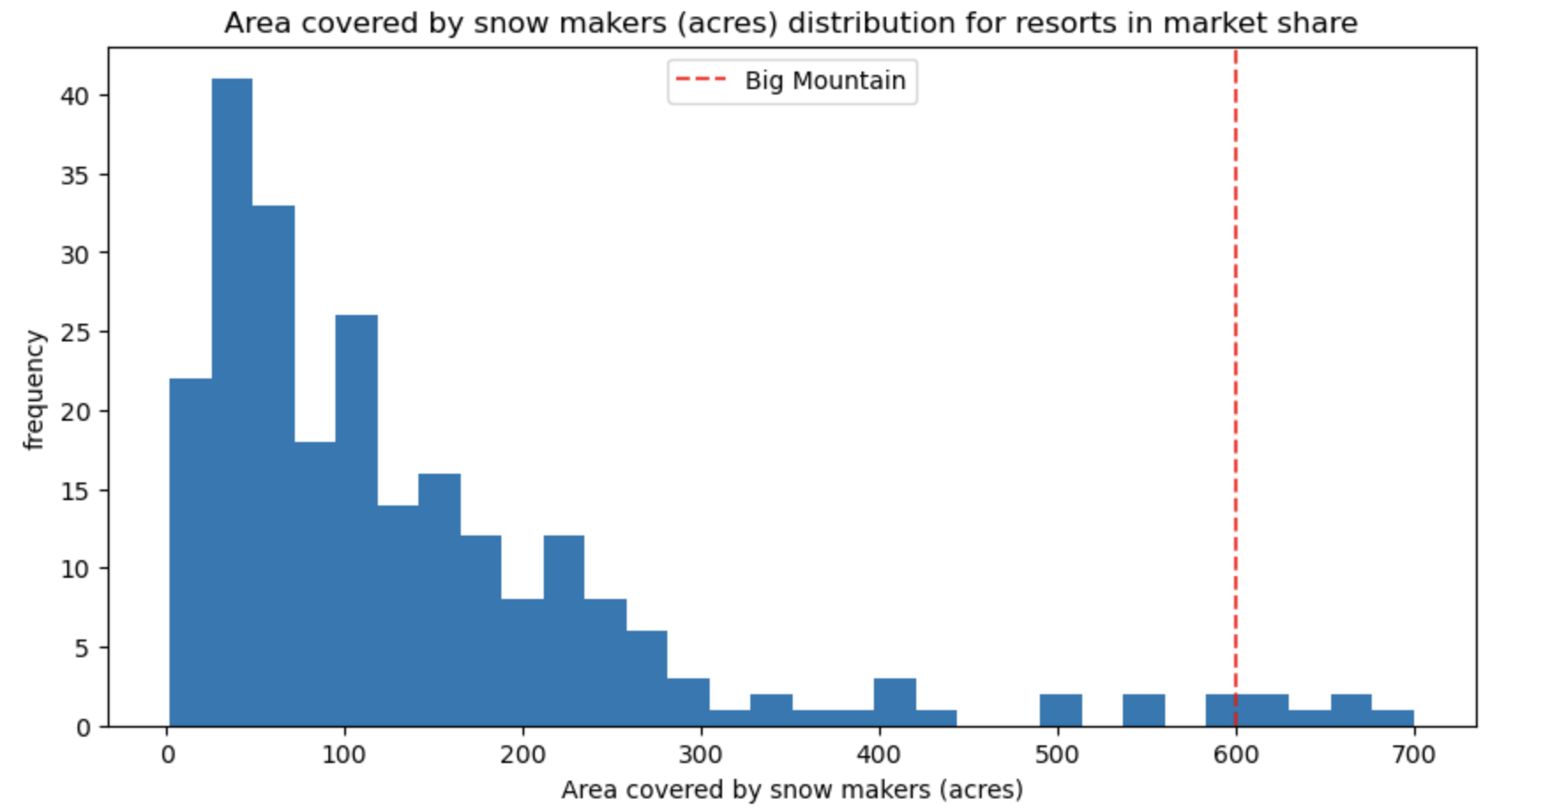
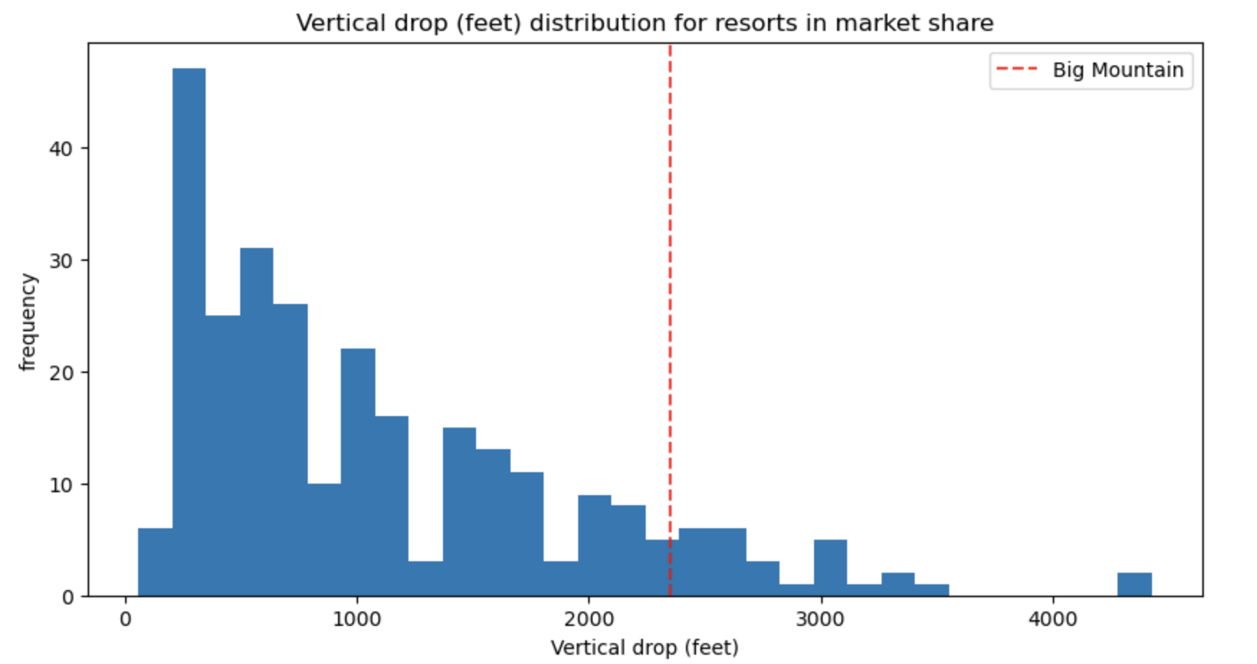
Where we stack up in key features

Slide 6
Summary
Big Mountain resort has a lot of amenities that matter to customers and are not charging enough for them.

